Slide 1
Senate Advisory Committee on Equity Diversity and Inclusion Our senate report and recommendations for academic year 2021-2022
Presenters
Drdave Derezotes
Chair Ageism and Rankism Subcommittee
Chair SAC-EDI
Dr. David Hawkins-Jacinto
Chair Culture Change Subcommittee

Slide 2
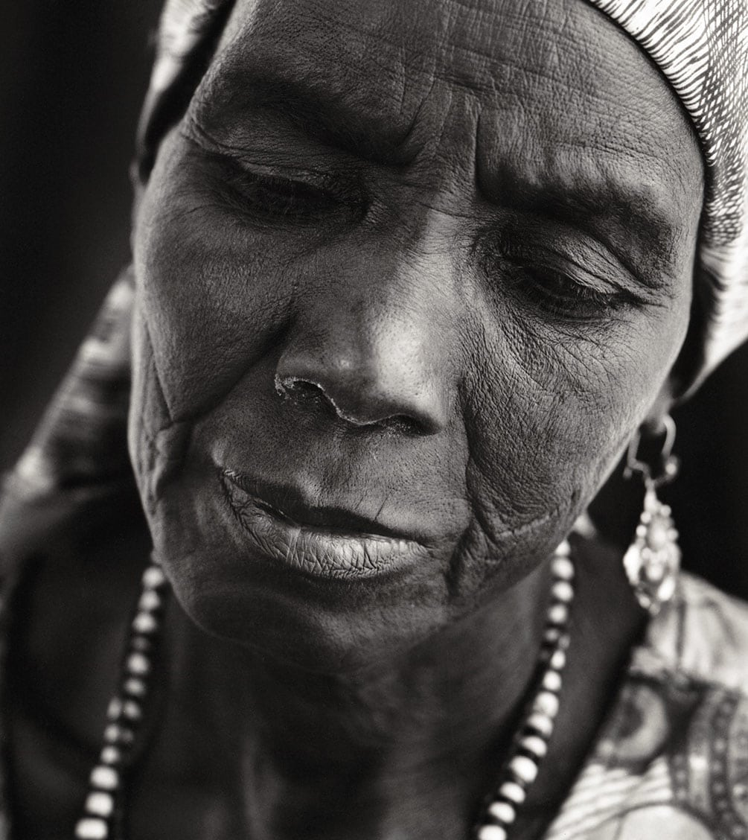
What is ageism?
Third most reported form of discrimination, across lifespan
Includes discharge, harassment, terms/conditions, discipline, promotion, hiring
Leads to economic, financial, psychological harm
U.S. Equal Employment Opportunity Commission
https://www.eeoc.gov/

Slide 3
What is Rankism?
Form of discrimination that can destroy an inclusive workforce
Abuses of power based upon rank
Includes workplace bullying
Leads to economic, financial, psychological harm
https://www.hrdive.com/news/expert-rankism-can-destroy-an-inclusive-workforce/417983/

Slide 4
All forms of discrimination cause unnecessary suffering

Slide 5
Diversity Action Plan & Practices (DAPP) Pilot
The Diversity Action Pilot will require at least 3 phases
Phase 1: Series of Workshops (2-3)
Introductory workshop – What is the DAPP? Where are diversity statements being used? What are the general benefits and best practices?
Faculty Intensive workshop – this workshop, tailored to each unit participating in the pilot, will feature document examples, discussion and a sharing/feedback session
Looking Forward workshop (optional) – a final workshop will focus on polishing the document and best practices for maintaining and updating the DAPP as well as using the document as a planning instrument for development

Slide 6
DAPP Pilot: Phase 2
Unit specific programming – units will be encouraged (and sponsored?) to plan their own event(s) that support faculty DAPPs. This may include:
Brown bag discussion(s)
Invited speaker(s)
Virtual events
Training sessions (e.g., implicit bias, culturally relevant teaching practices, anti-racist pedagogy, &c.)
Participation in discipline specific workgroups or natl’ organizations involved in EDI practices

Slide 7
DAPP Pilot: Phase 3
Resources Website – to further support participating units, a resource website will be developed that includes information regarding…
inclusive teaching practices,
EDI training & discussions (e.g., Friday Forums),
research methods & tools (e.g., implicit bias training),
affinity groups and belonging,
community engaged learning,
student support groups & U resource centers,
mentoring practices …&c.

