Slide 1
Senate Advisory Committee on Information Technology (SACIT)
Phoebe b. McNeally, SACIT CHAIR
March 14, 2022

Slide 2
SACIT Charge
“The primary role of the Committee is to ensure ongoing robust communication among representatives of the University’s academic users of information technology (especially faculty and students), and administrators responsible for planning for, acquiring and deploying information technology resources.”
(University Policy 6.002 III D.1.I; https://regulations.utah.edu/academics/6-002.php)

Slide 3
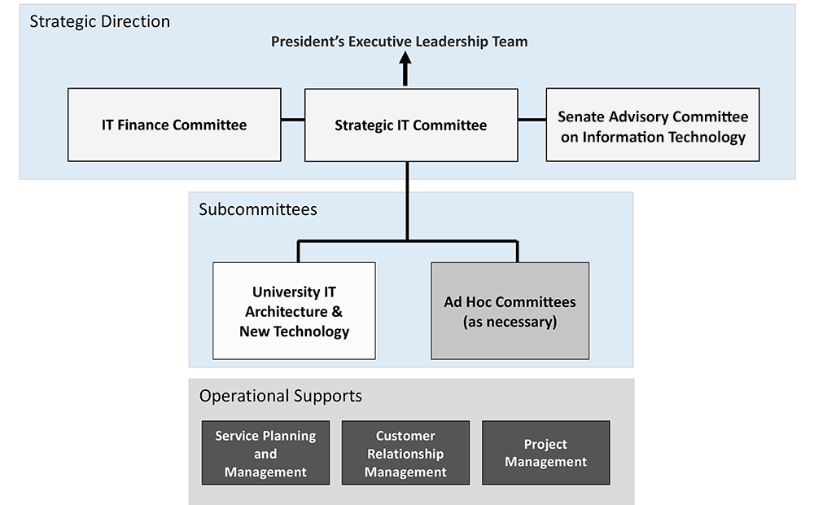
IT Governance Structure
https://it.utah.edu/cio/it-governance-committees/index.php

Slide 4
2021-2022 SACIT Activities
Major proposal discussed:
Proposed Rule 5-050B, University Software Acquisition Approval
Meetings:
October 1, 2021 with Steve Hess (CIO), Ken Pink (Deputy CIO), Corey Roach
December 3, 2021 with Steve Hess (CIO), Corey Roach (CISO) David Packham (UIT), Jon Thomas (UIT)
January 7, 2022 - with Steve Hess (CIO), Ken Pink (Deputy CIO), Corey Roach (CISO)
February 4, 2022 with Steve Hess (CIO), Ken Pink (Deputy CIO), Corey Roach (CISO) David Packham (UIT)
March 4, 2022 and April 1, 2022 (scheduled)

Slide 5
Proposed Rule 5-050b
Background:
Required by the 2018 State IT Security Audit report (received in 2019)
Addresses the ever increasing software cyber security concerns
Purpose:
“to provide the University the opportunity to review the security and accessibility of all software purchased, leased or developed by the University to ensure it meets current Information Security and Accessibility standards as determined by University Information Technology (UIT). “

Slide 6
Proposed Rule 5-050b Continued
Key components:
Applies to all units of the University of Utah for all software acquisitions
Requires the completion of Educause HECVAT, mandatory questions document and UIT security review and approval prior to acquisition
Required for all software that accesses, manipulates, creates or stores restricted data as outlined in University Policy 4-004c
Recommended for all software that accesses, manipulates, creates or stores sensitive data as outlined in University Policy 4-004c
Does not apply to software residing in a University approved Protected Environment or an environment not attached to the public internet or outside the unit
Committee approved: 11 yes, 0 no, 1 abstain, 1 absent

