Slide 1
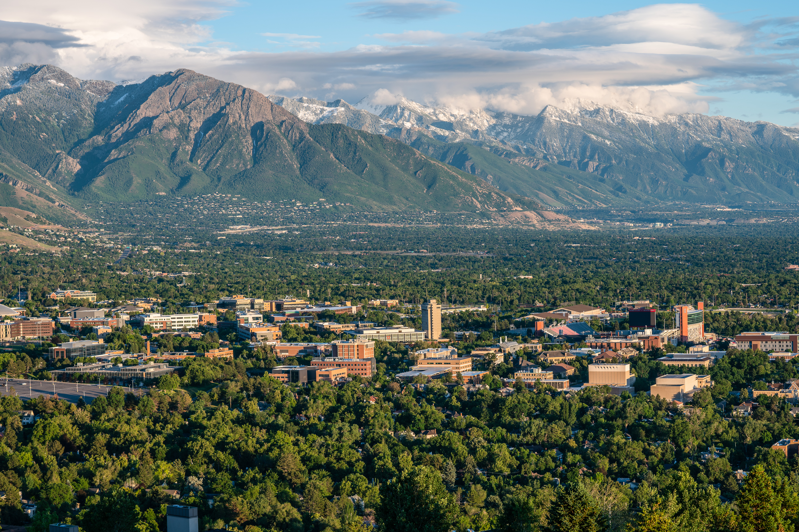
2023 College Elections Results
Senate, Undergraduate Council and
University Promotion and Tenure Advisory Committee
+
2023 Senate Leadership Elections
Academic Senate 5/1/23

Slide 2
Newly Elected Senators for AY 23 - 24 (Last Updated 5/1/2023)
College of Education | Paula Smith
College of Engineering | Roseanne Warren
 | Doug Christensen
 | Sarang Joshi
College of Fine Arts | Julie Wright-Costa
College of Health | Timothy Brusseau
 | Lorie Richards
College of Humanities | Katharine Coles
 | Rachel Hayes-Harb
 | Margaret Wan
 | Curtis Newbold
College of Mines & Earth Sciences | Kevin Perry
 | Mark Loewen
College of Nursing | Caroline Stephens
 | Lynn Reinke
College of Science | Martin Horvath
 | Sarah Bush
College of Social & Behavioral Science | Franks Drews
 | Katie Durante
 | Rick Forster
 | Christopher Simon
David Eccles School of Business | Rohit Aggarwal
 | Bryan Bonner
Libraries | Noreen Farley
S.J. Quinney College of Law | Jensie Anderson
School for Cultural & Social Transformation | Lourdes Alberto
School of Dentistry | Brent Milne
Spencer Fox Eccles School of Medicine | David Turok
 | Naomi Schleisinger
 | Robert Campbell
 | Huong Meeks
 | Ademuyiwa Aromolaran
QIDT | Ginger Smoak
Deans | Hollis Robins

Slide 3
Senate Committee Election Results
Senate Advisory Committee on Academic Policy
 | Mary Beth Vogel-Ferguson*, Social Work
 | Matthew Cecil, Science
 | Jennifer Lehmbeck, Health
Senate Advisory Committee on Equity, Diversity, and Inclusion (TL)
 | Jong Hoon Kim, Fine Arts
 | Ademuyiwa Aromolaran, Medicine
 | Berardi Sensale Rodriguez, Engineering
 | Christy Porucznik, Medicine
Senate Advisory Committee on Equity, Diversity, and Inclusion (CL)
 | Trace Daniels Lerberg, Humanities
 | Clifton Uckerman, Social Work
Senate Faculty Review Standards Committee
SFRSC - 1 TL faculty from Business | Jen Brown
SFRSC - 1 TL faculty from Fine Arts | Chris DuVal
SFRSC - 1 TL faculty from Education | Andrea Rorrer
SFRSC - 1 CL faculty University-Wide | Sankar Srinivasan, Business
Senate Advisory Committee on IT
 | Kelly Broadhead*, Engineering
 | Joy Pierce, Humanities
 | Charles Jui*, Science
 | David Goldenberg*, Science
Senate Committee on Academic Freedom and Faculty Rights
 | Brent Steele, CSBS
Senate Advisory Committee on Student Course Feedback
 | Jess Tidswell, Health
* = served on committee for 2022-23 term

Slide 4
Undergraduate Council (Last Updated 4/14/2023)
College of Architecture and Planning | Steven Chodoriwsky
College of Fine Arts | Donn Schaefer
College of Humanities | John Stone
College of Science | Jordan Gerton
College of Social & Behavioral Science | Lazarus Adau
College of Social Work | Stephanie Bank
Libraries | Marnie Powers-Torrey

Slide 5
University Promotion and Tenure Advisory Committee (UPTAC) (Last Updated 4/14/2023)
College of Engineering | Marc Porter | (alt) Kam Leang
College of Health | Maria Newton | (alt) Dorothy Schmalz
College of Social & Behavioral Science | Andrea Brunelle | (alt) Timothy Smith
S.J. Quinney College of Law | Clifford Rosky | (alt) TBD
School for Cultural & Social Transformation | Matt Basso | (alt) Andrea Baldwin
School of Dentistry | Glen Hanson | (alt) Annette Fleckenstein
Spencer Fox Eccles School of Medicine | Dr. Jose Rodriguez | (alt) Dr. Daniel Scharfstein

Slide 6
2023 Senate Leadership Elections
Academic Senate 4/14/23

Slide 7
Senate Personnel & Elections Committee (SPEC):
Elections for May 1, 2023
    Mike Braak
    mike.braak@utah.edu
    Paul Mogren
    paul.mogren@utah.edu
    will administer the elections during this session.
    The Election Ballot will remain open in the Qualtrics platform for approximately 30 minutes

Slide 8
Senate Personnel & Elections Committee (SPEC):
Elections for May 1, 2023
    1 Senate President-elect
    3-year term
    12 Senate Executive Committee 2023-2024 members
    1-year term and must be a 2023-2024 Senator
    1 Personnel & Elections Committee member approval
    3-year term

Slide 9
Senate Personnel & Elections Committee (SPEC):
Elections for May 1, 2023
    Senate President-elect Candidate
    Harriet Hopf
    College of Medicine, Tenured

Slide 10
Senate Personnel & Elections Committee (SPEC):
Elections for May 1, 2023
    Senate Executive Committee Candidates
    Ademuyiwa Aromolaran (Medicine)
    Jen Brown* (Business)
    Timothy A. Brusseau (Health)
    Nanette Dudley (Medicine)
    Julia Franklin (Health)
    Gina Frey (Science)
    Tucker Hermans* (Engineering)
    Jay Jordan (Humanities)
    Paul Shami (Medicine)
    Christopher Simon (CSBS)
    Patrick Tripeny* (Architecture)
    Jaclyn Winter* (Pharmacy)
    Zhou Yu (CSBS)
    *denotes current member who would like another term

Slide 11
Senate Personnel & Elections Committee (SPEC):
Elections for May 1, 2023
    Senate Personnel & Elections Committee Candidate
    Brenda Van der Wiel*
    College of Fine Arts
    *denotes current member who would like another term

